Slide 1
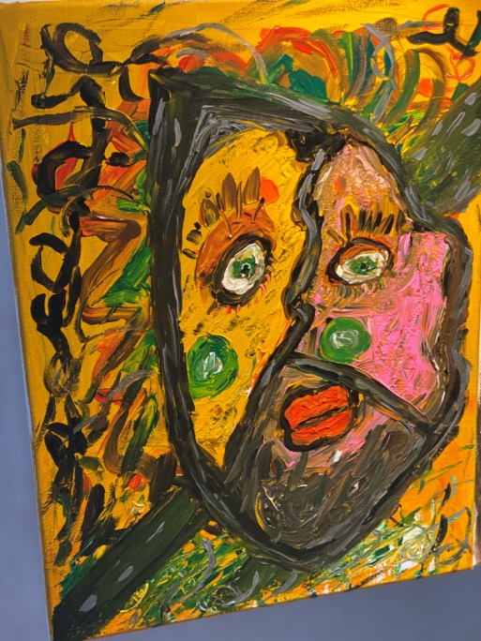
Alexander Papanikolaou
2.1 creative arts relations
Notes:
My journey and key moments through creative arts

Slide 2
The terrible deathless beauty
As we get into the immortalising battle ——- We are singing full of joy
us the sons of Troy,———————–in strong shiny armour
being brave and proud, ——————–facing enemies, in millions
We fight for the Ilion,——————— defying the old ferryman’s duty
We fight for beauty ———————–for the terrible deathless beauty.
The stake is high————————-It is not God’s forbidden
Our destined fate is already written———-to fight for beauty
What a remarkable duty——————-is blessed and high
to be doomed and die—————— the old ferryman’s duty daring to defy
for the terrible deathless beauty————for this terrible deathless beauty.

Slide 3
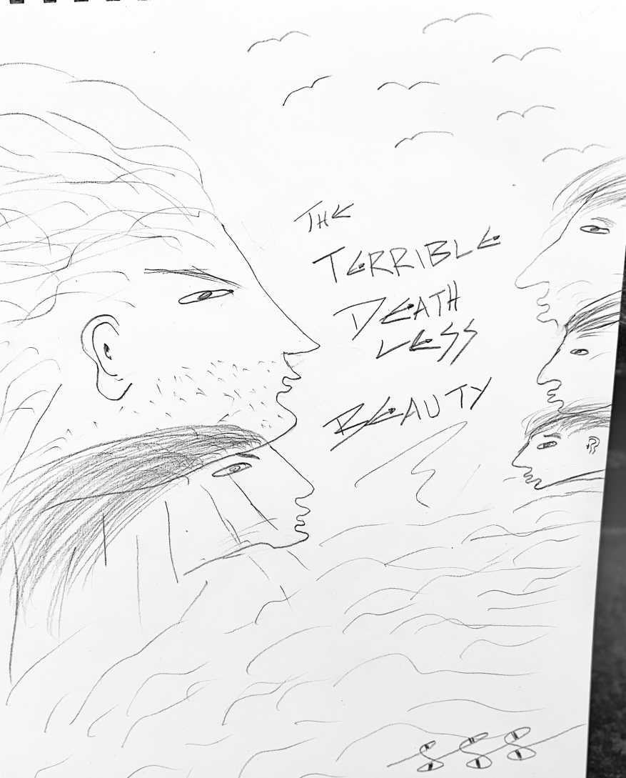
The terrible deathless beauty sketch

Slide 4
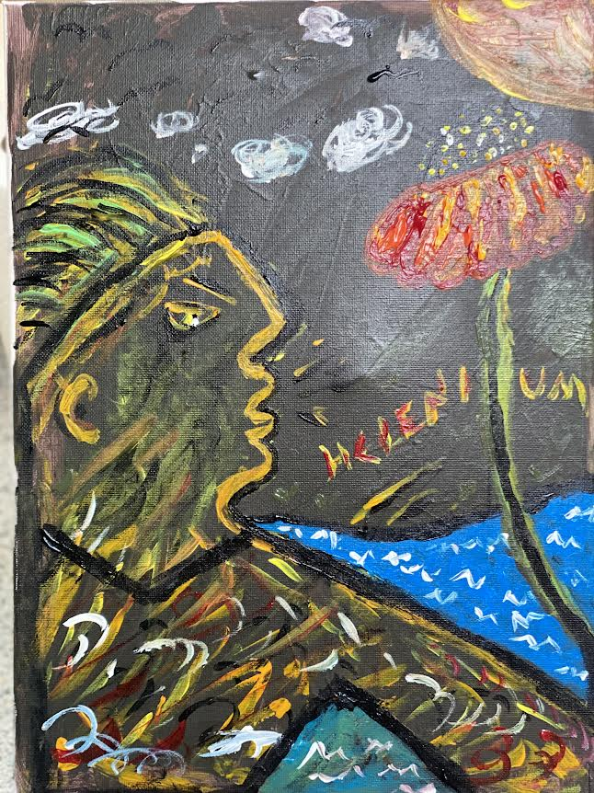
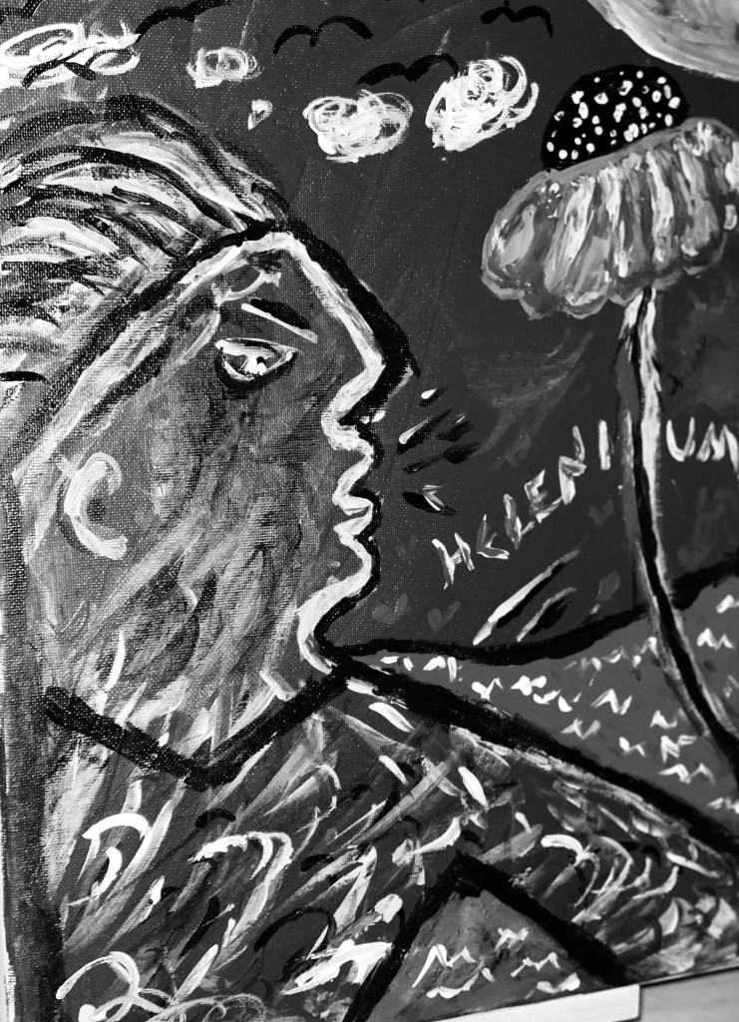
HELENIUM

Slide 5
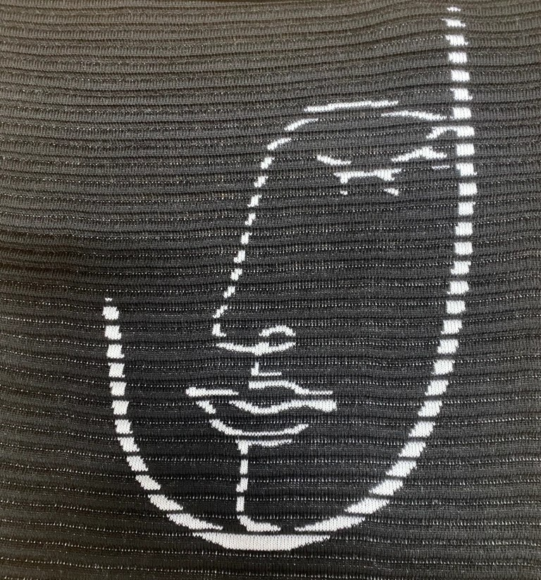
TEXTILE FACE

Slide 6
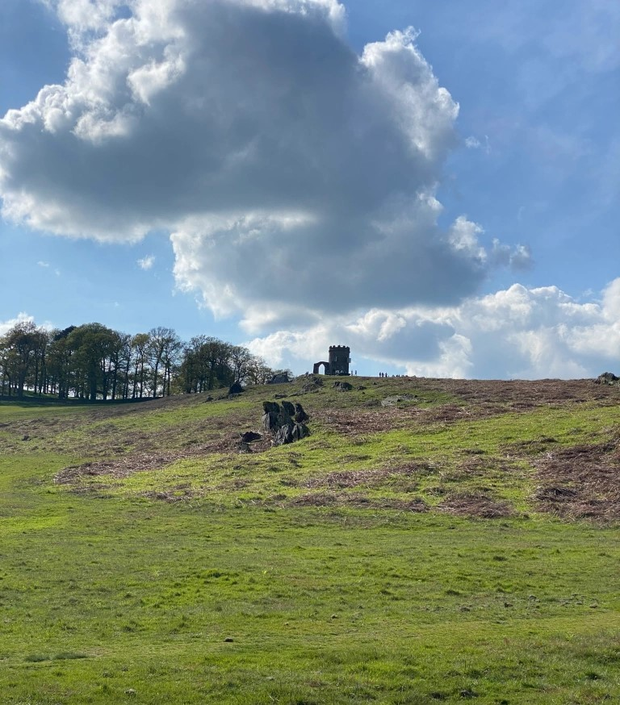
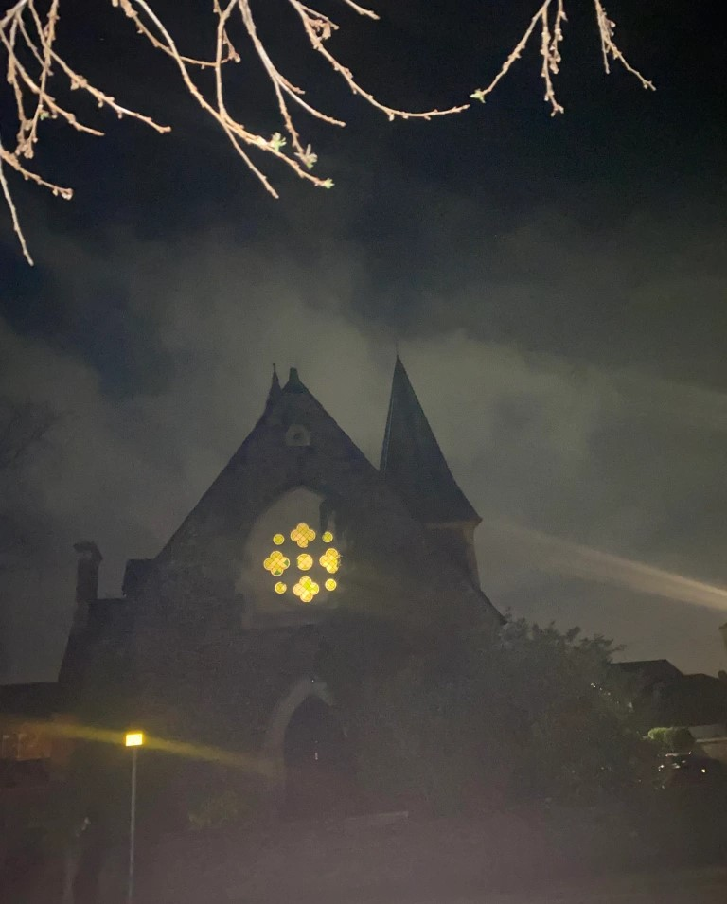
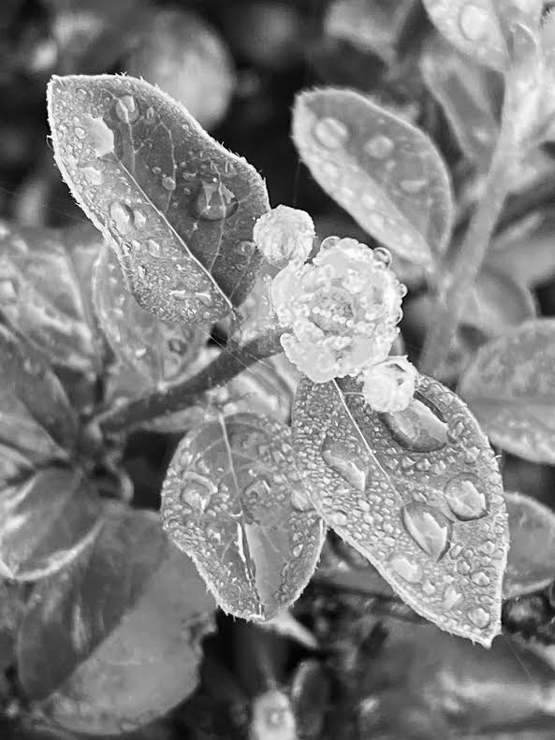
PICTURES

Slide 7
CHURCH TURN INTO A HOUSE

Slide 8

HELEN’S FACE

Slide 9
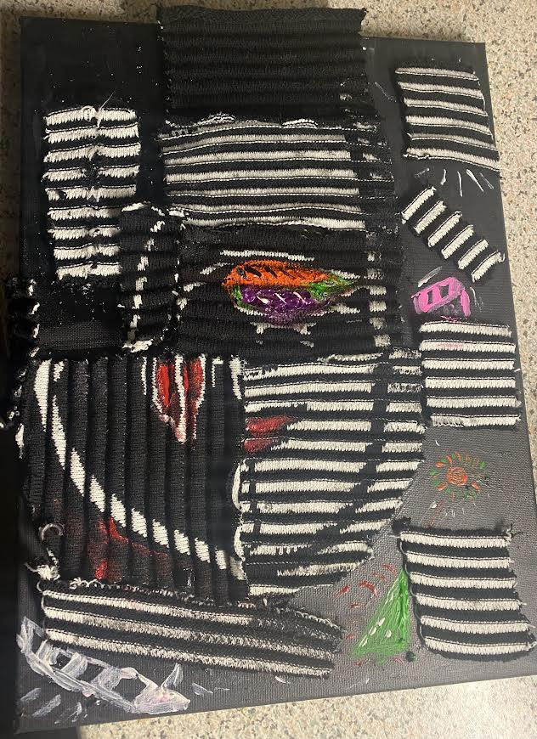
TEXTILE COLLAGE

Slide 10
HELENA: THE CAUSE FOR LOSS
Helena, beautiful Helena.
What did she know when she was born?
How did Fate and Nemesis curse her?
How many lives have been torn?
A thousand ships have sailed, Helena
looking for a shadow, a flawless silhouette
Trojans and Greeks’ heroic deaths have suffered
being Olympian god’s fatal marionette.
The whole world was split in two: Helena,
Gods and humans fight for honour and pride,
looking for the ultimate price, Helena.
Moreover, everyone had to choose a side.
And when the war was over, Helena,
when Ilion vanished in smoke and flame
Gods declared peace, Helena
quickly blaming an evil, ungodly dame!
An everlasting name, Helena
reminding a ten-year mythological war
but considering the circumstances
what happens to the modern world?
Humanity is always looking for a Helena.
To personify the Evil or a Cause.
To accomplish their deeds and pursuits
to justify horrifying pain and loss.

Slide 11
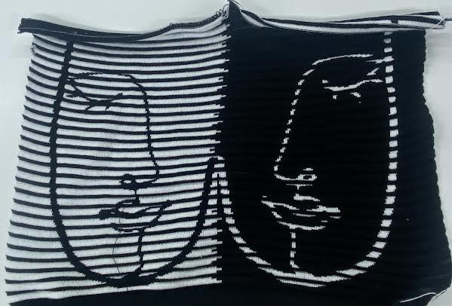
YIN AND YANG

Slide 12
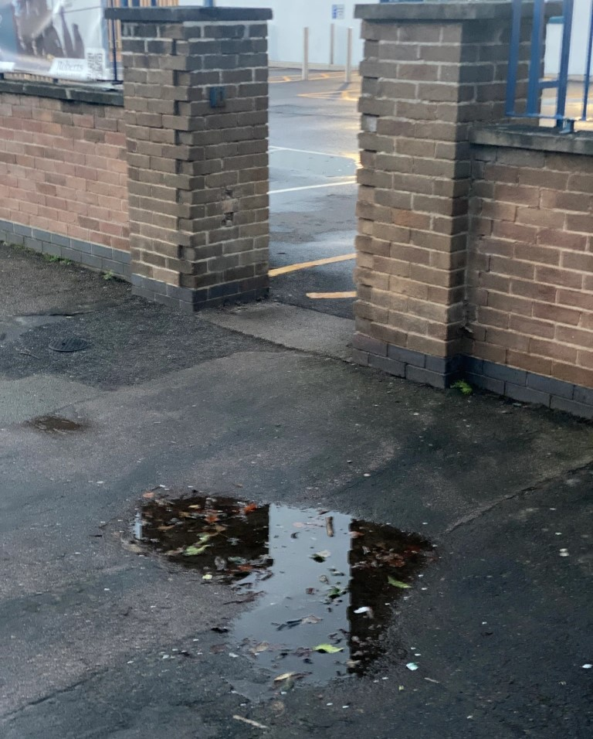
HEART PUDDLE

Slide 13
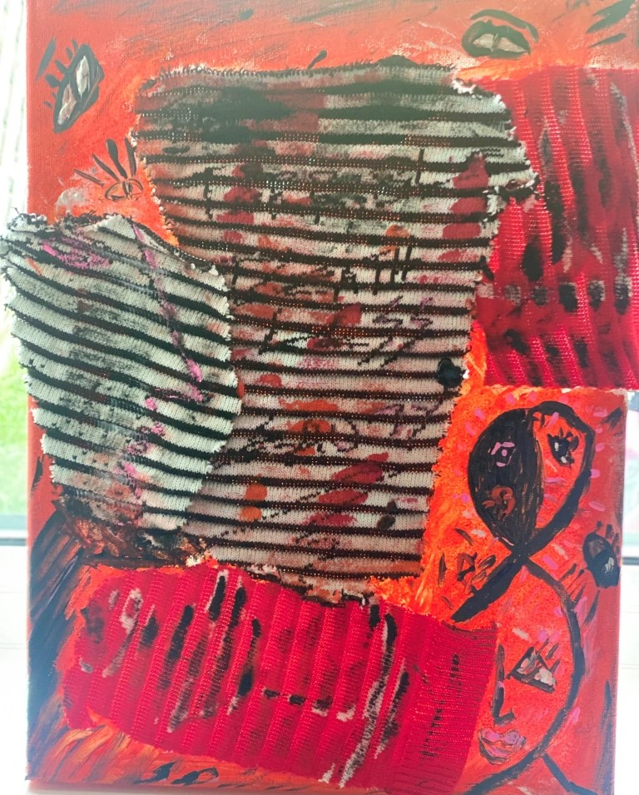
TEXTILE SKETCH COLLAGE

Slide 14
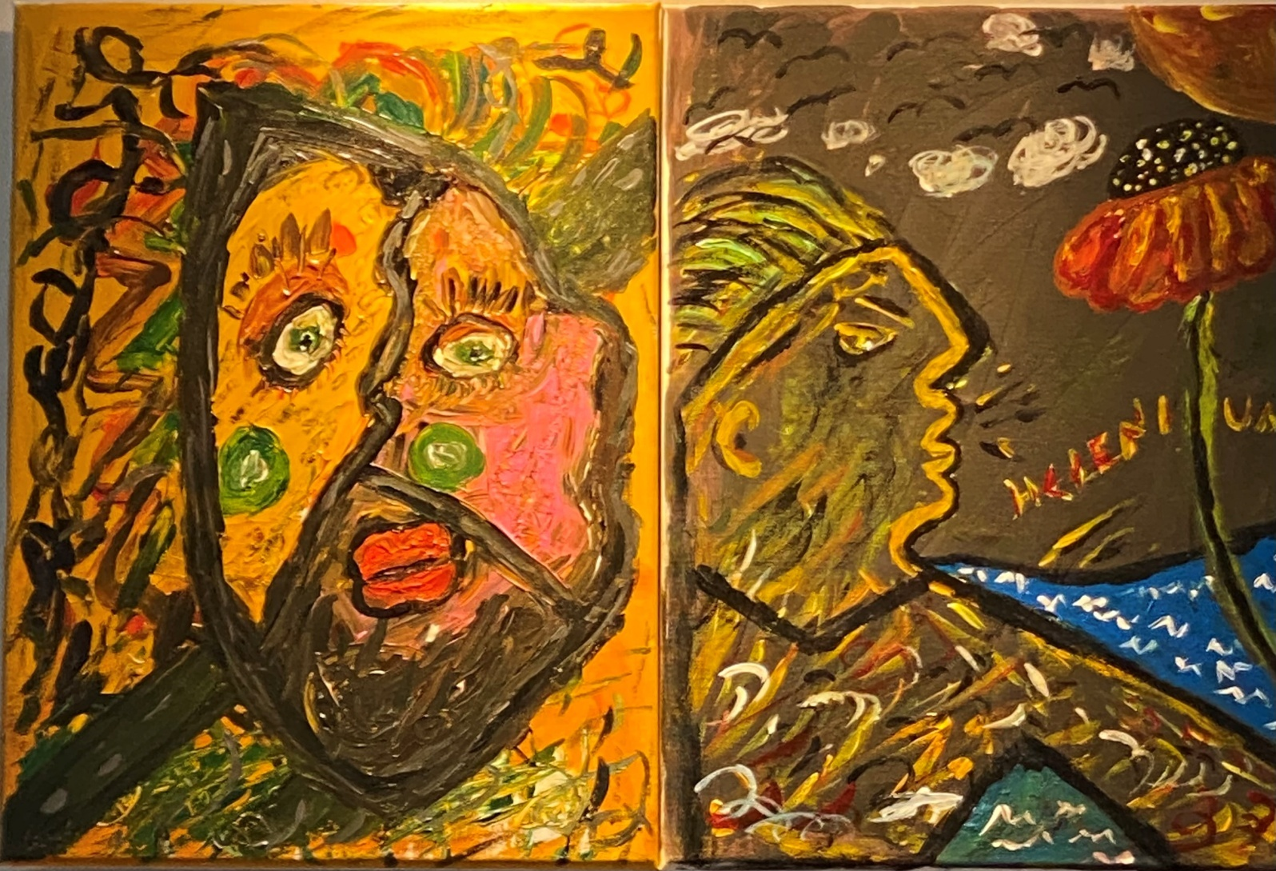
THE END

